Slide 1
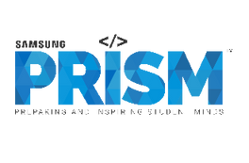
Samsung PRISM Monthly Connect Discussion
Network Monitor Utility
Team Members:
College Professors:
Dr. Thiripurasundari D / dthiripurasundari@vit.ac.in
Dr. Richards Joe Stanislaus / richards.stanislaus@vit.ac.in
Students:
Shubham Singh / shubham.singh2021@vitstudent.ac.in
Sourav Patel / sourav.patel2021@vitstudent.ac.in
Ashrit Saha / ashrit.saha2021@vitstudent.ac.in
Navin Kumar L / navinkumar.l2021@vitstudent.ac.in
Utkarsh Pandey / utkarsh.pandey2021a@vitstudent.ac.in
Department: CSE and ECE
Date: 10 Jan 2024

Slide 2

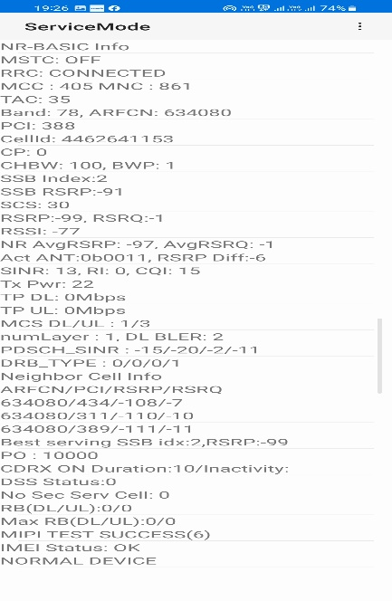
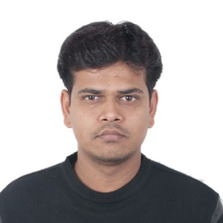

Utility to read live RF Network Parameters
Work-let expected duration – 3 months
3-5
Problem Statement
Reading of RF network parameters using Samsung Keystring app during testing of modem feature like call, video streaming is not good option for any automation. Also, using 3rd party apps does not serve the purpose. Hence, we need an utility to fetch live RF parameters like Band, Bandwidth, PCI, RSRP, etc. from the device and this utility should be able to integrate to any automation with such requirement.
Network parameters are keeps changing in seconds and reading values in above method will not give live readings.
Monitoring network changes like handovers, RAT changes etc. plays crucial role in analysing network stability.
Members
Expectations
Solution to create an Android app utility service to continuously read network RF parameters like RSRP, SINR, Band, Bandwidth, etc. for LTE, NSA & SA network infrastructure using telephony APIs or any other better approach for all chipset devices and available SIMs.
Solution to monitor and fetch changes in live RF parameters including call drops, data stalls, scg failures, CA status, Handovers, PCI/RAT changes, Band change,BW change,
Solution to have CLI or API’s exposed to fetch above mentioned data.
Use Telephony APIs / Google APIs to read network parameters.
Desktop JS server should be developed with MongoDB database.
Store the route with lat and long along with all nw data to database for mobility cases.
Track call status and call drop status with location details.
Training/ Pre-requisites
Good knowledge on Android, Telephony APIs, 4G and 5G understanding and JAVA Programming skills.
Kick Off < 1st Month >
Setup and requirement discussion.
Explore available telephony and Google API’s and read all RF network parameters.
Develop CLI or API to use developed utility.
Android APIs/Services
1. Start service.
2. Keep posting all the rf parameters every
second.
3. Stop service.
. Desktop JS server should be developed with MongoDB database.
Milestone 1 < 2nd Month >
Each information from the android API service should be dumped to the DB.
Monitor & post if any change in nw - PCI change, RAT change, SCG Failure, Handovers notifications.
Fetch , pass and save data every second.
Add SCG failures, CA status, Handovers, PCI/RAT changes, Band change, BW change identification features.
Closure < 3rd Month >
Call drop, data stall identification feature development.
Implement API’s to fetch info and RF parameters on available SIM cards on the device.
< Photo >
Additional Documentation:
RadioAccessSpecifier | Android Developers https://developer.android.com/reference/android/accessibilityservice/AccessibilityService
NI RF Data Recording API Documentation - NI
SRIB Contact 1,
Senior Chief Engineer
Nandeesh.c@samsung.com
+91-9886788762
SRIB Contact 2,
Senior Chief Engineer
Sai.dileep@Samsung.com
+91-8095040421

Slide 3
Key Performance Indicators (KPIs) Achieved Till Now
Work-let Name: Network Monitor Utility
Work-let ID: 23SE15
College Name: Vellore Institute of Technology (VIT), Chennai
Created an intuitive and user-friendly interface, integrating visually appealing design elements and streamlined navigation to enhance overall user experience.
Secured all essential permissions to ensure seamless functionality and optimal performance of the app.
Full Network Access, View Network Information, Wi-Fi Connections, Prevent Phone from Sleeping, Run at Start-up and Foreground Services.
Acquired fundamental knowledge of the RF parameters and their measurement techniques for LTE, 5G NSA and 5G SA network infrastructures, to deliver comprehensive insights into the network performance.
Researched and explored Telephony APIs thoroughly to gain a comprehensive understanding of their functioning and capabilities.

Slide 4
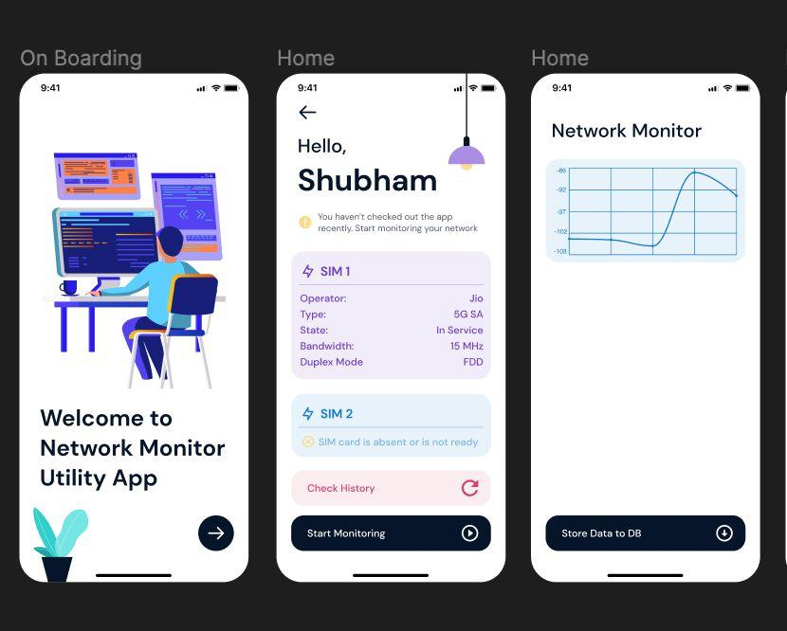
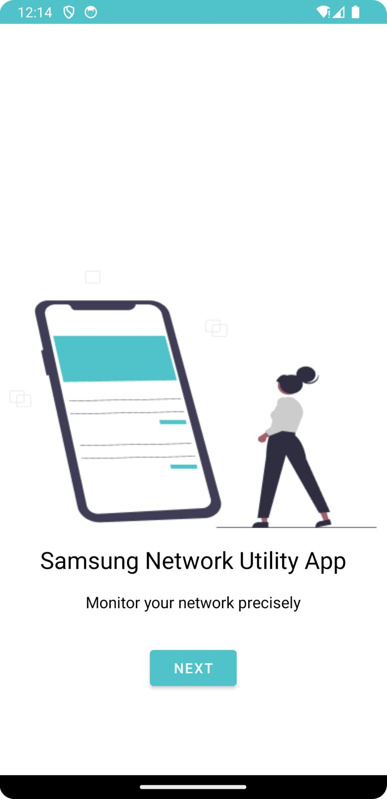
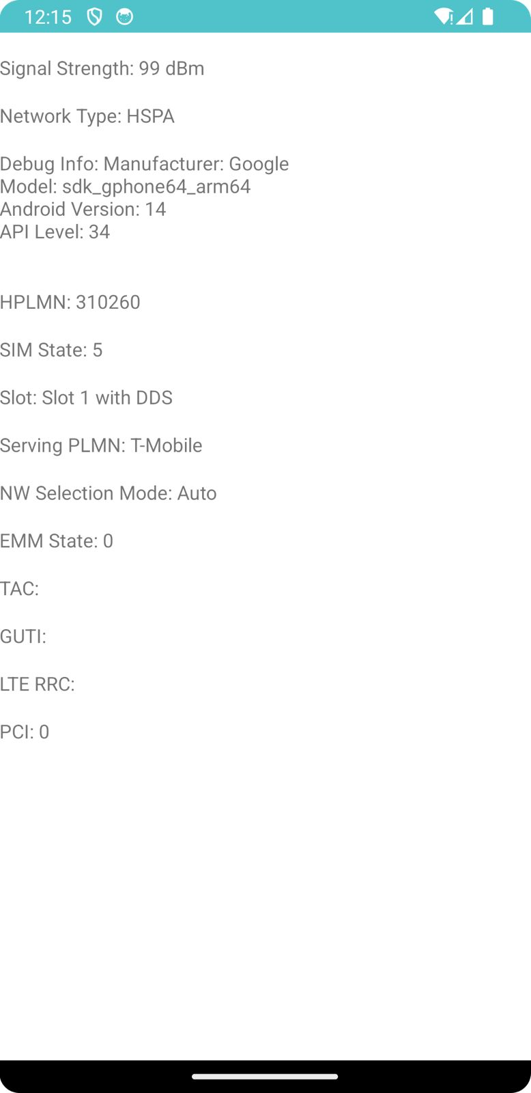
Key Performance Indicators (KPIs) Achieved Till Now
Work-let Name: Network Monitor Utility
Work-let ID: 23SE15
College Name: Vellore Institute of Technology (VIT), Chennai

Slide 5
Any Challenges / Issues Faced
Work-let Name: Network Monitor Utility
Work-let ID: 23SE15
College Name: Vellore Institute of Technology (VIT), Chennai
Network Compatibility- Handling diverse network infrastructures like LTE, 5G NSA and 5G SA pose challenges due to variations in their implementations.
Real-Time Parameter Updates- Implementing a mechanism for real-time updates of RF parameters pose a challenge as it involves frequent data retrieval and display.
Telephony API Compatibility- Ensuring compatibility with different Android versions and devices pose a challenge, especially when utilizing Telephony APIs for fetching RF parameter data.
Optimizing Network Traffic Monitoring- Efficiently monitoring network traffic without causing significant battery drain or performance issues is a major challenge.
User Permissions- Handling and explaining app permissions to users, especially those related to telephony data.
User Interface (UI) Design- Creating an intuitive and user-friendly interface that effectively communicates complex RF parameters in a comprehensible manner without overwhelming the users is a major design challenge.
Testing Across Devices- Ensuring the app’s performance and accuracy across a diverse range of Android devices each with its own specifications.
Security Concerns- Ensuring the security of user data and sensitive information is a major security challenge.

Slide 6
Next Steps
Work-let Name: Network Monitor Utility
Work-let ID: 23SE15
College Name: Vellore Institute of Technology (VIT), Chennai
Fetch all the essential RF parameters corresponding to the network infrastructure.
Store the RF parameters data efficiently in a MongoDB database.
Create a user-friendly Command Line Interface (CLI) and Application Programming Interface (API) to facilitate transmission of the collected data.
Effectively manage and respond to significant network events.
Call Drops, Data Stalls, Secondary Cell Group (SCG) Failures, Carrier Aggregation (CA) Status, Handovers, Physical Cell Identity (PCI) Changes, Radio Access Technology (RAT) Changes, Band Change and Band Width (BW) Change.
Visualise the fetched data and previously stored information through the use of plots, graphs and other graphical representations.
Implement a notification system to alert users about any changes in the network.
Enhance the user-interface for a more intuitive and visually appealing experience.

Slide 7
Key Achievements / Outcome Till Now
Work-let Name: Network Monitor Utility
Work-let ID: 23SE15
College Name: Vellore Institute of Technology (VIT), Chennai
Completed the setup process of the app, ensuring a smooth and efficient start.
Addressed all necessary permission requirements crucial for the app‘s functionality.
Acquired a comprehensive understanding of the essential RF parameters for LTE, 5G NSA and 5G SA network infrastructures.
Explored available Telephony APIs and integrated them to effectively retrieve RF parameter data.
https://docs.google.com/spreadsheets/d/1ioE3sOUk1SmHGiDsDABTBq_D2PdW_dJ6/edit#gid=1742792295
Successfully retrieved and displayed a couple of RF parameter data points for analysis.

Slide 8
Questions
Work-let Name: Network Monitor Utility
Work-let ID: 23SE15
College Name: Vellore Institute of Technology (VIT), Chennai
Is there a preferred UI design template to follow or creative freedom is allowed for the interface?
How should we visually represent both the real-time data fetched and the stored information for optimal comprehension?
Should we include a data download feature, allowing users to access fetched real-time data and stored information for offline analysis or record-keeping?
Should we implement a feature that enables users to customize the time duration for data fetching, providing flexibility with options like 250ms, 500ms, 1s, 2s intervals?
Should we extend the monitoring capabilities to include parameters related to Wi-Fi connections for a more holistic overview of network-related information?

Slide 9
Thank You

